Slide 1
Automatic Detection of Mode interactions using Machine Learning
06/02/2023
Lina Ben-Younes
Supervised by Dr Renson

Slide 2
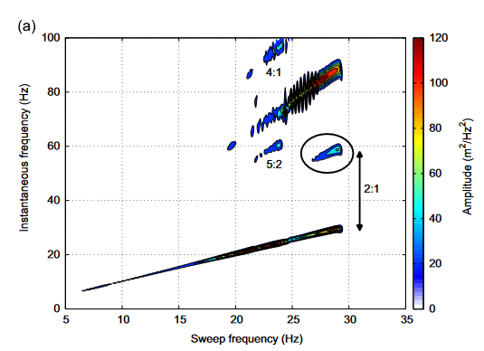
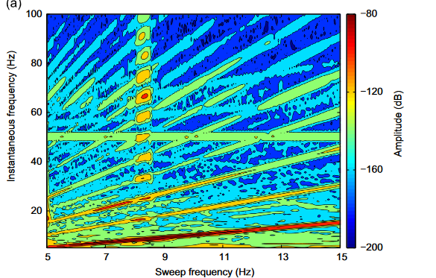
Complex dynamics of a nonlinear aerospace structure: Experimental identification and modal interactions J.P. Noël n, L. Renson, G. Kerschen Journal of Sound and Vibration
Automatic Detection of Mode interactions using Machine Learning
06/03/2023

Slide 3
Area of work & Objectives
06/03/2023
Project goals:
Identifying the patterns, parameters and favourable conditions of modal interactions.
Creating scalogram datasets of nonlinear models with and without model interactions.
Creating pre-processing protocols for these scalograms,
Training and cross-validating different Machine Learning models on those datasets.
Testing them on real-life data.
Automatic Detection of Mode interactions using Machine Learning
Lina Ben-Younes

Slide 4
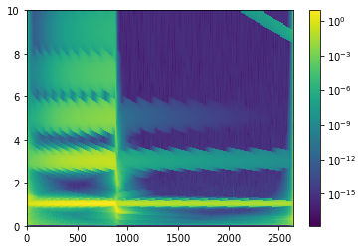
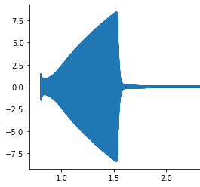
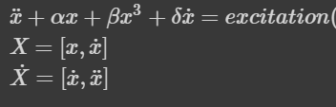
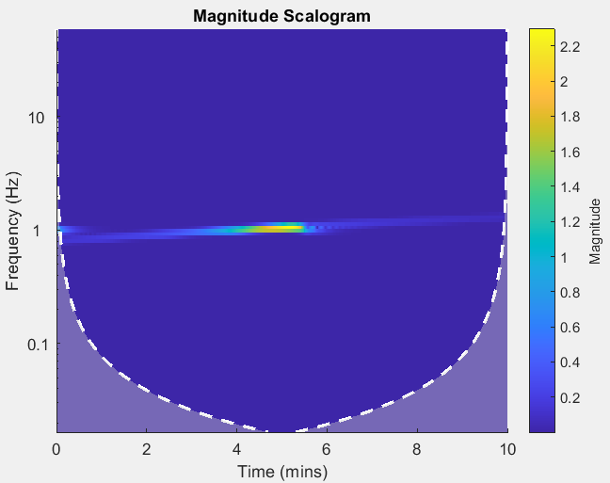
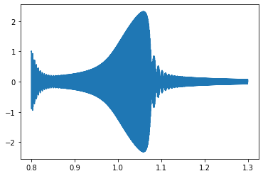
Duffing 1DOF. No mode interaction
Automatic Detection of Mode interactions using Machine Learning
06/03/2023

Slide 5
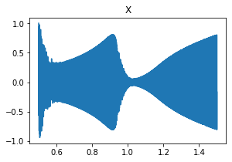
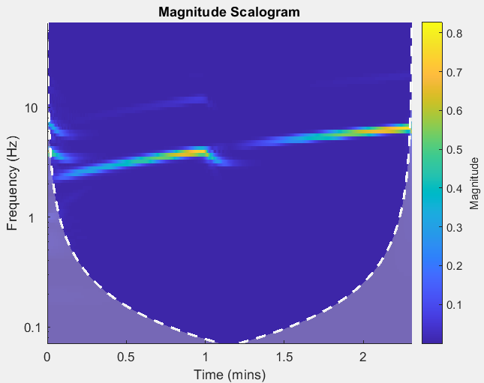
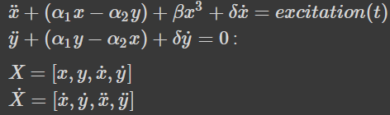
Duffing 2DOF. 1:3 Interaction
Automatic Detection of Mode interactions using Machine Learning
06/03/2023

Slide 6

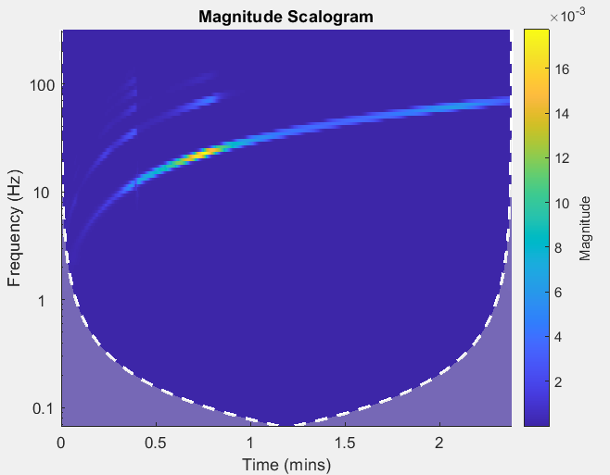
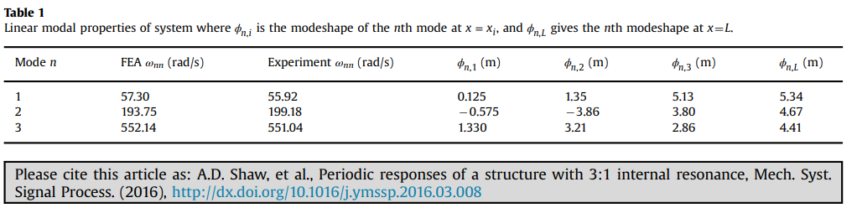
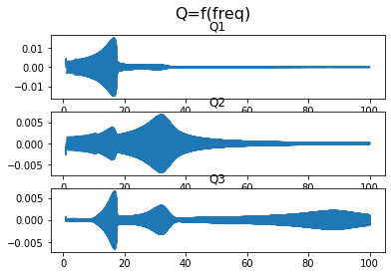
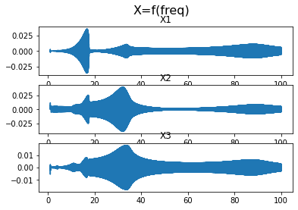
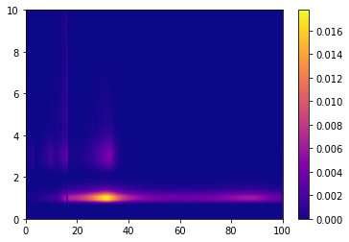
Beam I.
Automatic Detection of Mode interactions using Machine Learning
06/03/2023

Slide 7
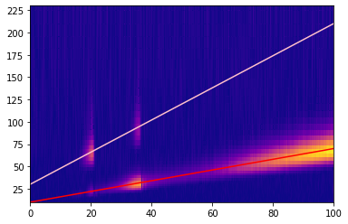
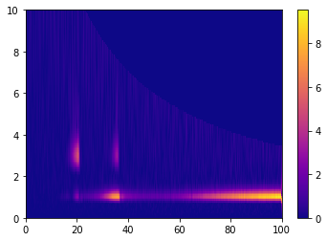
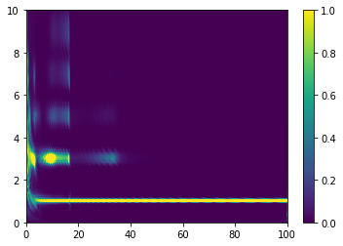
Prescaling
Automatic Detection of Mode interactions using Machine Learning
06/03/2023
Frequency
Amplitude

Slide 8
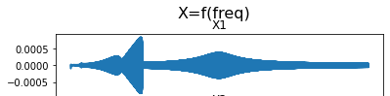
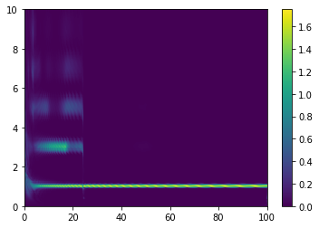
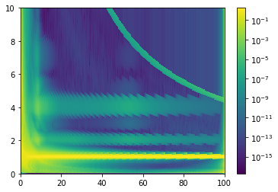
Beam II. Other modes
Automatic Detection of Mode interactions using Machine Learning
06/03/2023

Slide 9
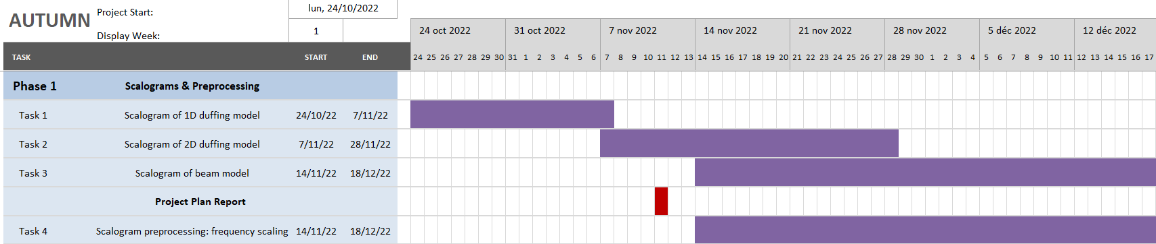
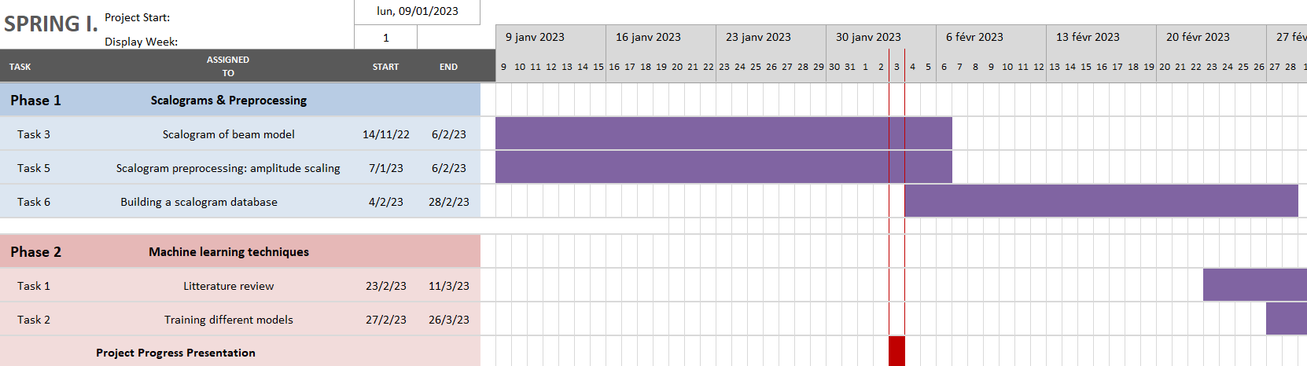
Gantt & Statement of future work
Automatic Detection of Mode interactions using Machine Learning
06/03/2023

Slide 10
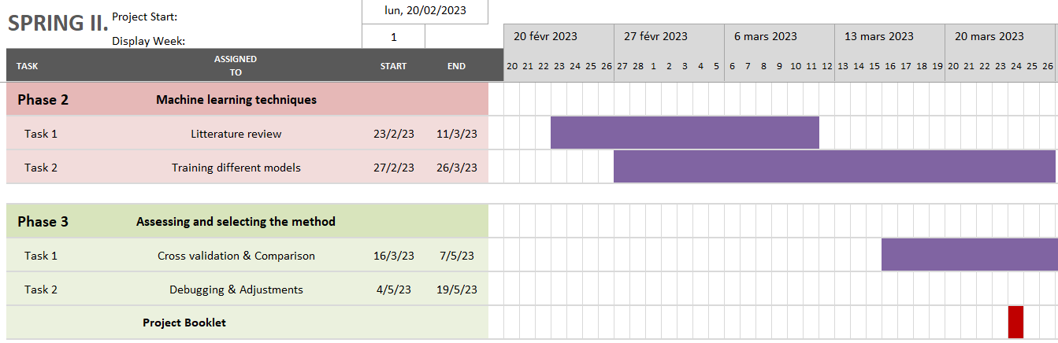
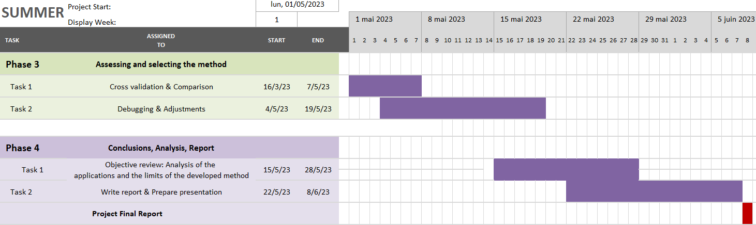
Gantt & Statement of future work
Automatic Detection of Mode interactions using Machine Learning
06/03/2023

